Slide 1
BLOCKCHAIN 101
Notes:
Hello all and welcome to the Blockchain 101 session.
Today we are going to have a very high level look into the blockchain technology. But before we get there lets start by looking into how world has seen major technology adaptions and what block chain brings on.

Slide 2
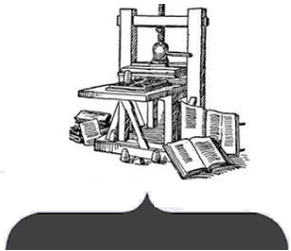

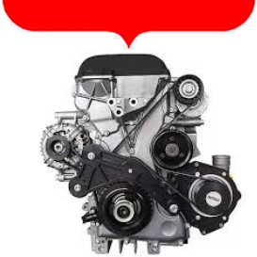
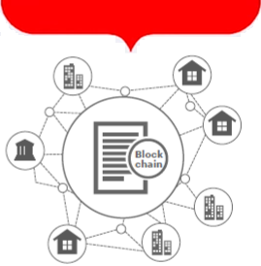
1800:Power Gap
2000:Trust Gap
1400:Knowledge Gap
1900:Distance Gap
Notes:
Looking at the key mile stones that world have seen and the areas they addressed.
Before printing press was invented books were handwritten and were only available to few anointed. In 1400 with invention of the printing press books/information reached a major population in the society and filled an interesting gap the Knowledge Gap.
The next major invention was the Engine, it filled the power Gap. At the time when we wanted to manufacture and we only had man power invention of engines brought a major push during industrial revolution.
The next and the most favorite invention the internet. Started in 1977 with just few computers just managing to send few
Bytes of data. Today it has reached almost everywhere in the world, enabling people to connect to just about any distance. Internet has filled the distance gap.
However even with the ability to connect there is a Trust gap in the society. There is an invention very in its very early stage that looks to fill this trust gap, this technology is called Blockchain. It would going forward change the way people and business transact with each other going forward.
Before we get into block chain lets see a fundamental concept of application topologies.

Slide 3
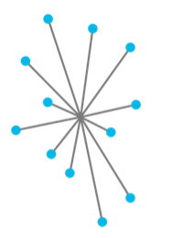
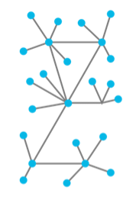
Centralized
De-Centralized
All nodes connect to central node. Ex WWW
Single point of failure, scaling, inefficiency
P2P network
All nodes are equal
Notes:
In a centralized architecture all clients or nodes connect to a central node for its resources. An example is a WWW or a centralized database that provides the computing and store for its application. There are well known problems with this architecture. Like:
Central single point of failure. If the central node is impacted all nodes are impacted.
Inefficient scaling
Decentralized network is a peer to peer network in which all nodes are equal. Primary characteristics to remember about blockchain is that it follows peer to peer model in which all nodes are equal.
There are other kind of challenges and complexities involved with this kind of architecture. But at core it does not suffer from single point of failure or scalability issues.
Having set these basic grounds lets start by looking at what are we going to discuss today.

Slide 4
Agenda
What is a Blockchain?
Background Blockchain Technologies
How does Blockchain fits in software architecture?
How Bitcoin works?
When is Blockchain applicable?
Implementations of Blockchain
Questions?
Notes:
In todays session we will have an introductory look at the blockchain.
As this is an introductory session we would start with understanding the fundamentals of blockchain in very basic terms. We will not be diving into any technical or platform specific implementations.
However the concepts discussed here are more generic in nature and will apply fully or to a larger extent to most of the variants of Blockchain technologies.
After this session you would be able to understand What the block chain is Where it evolved. Where to go from here. Lets start by looking at today’s agenda.
If we get sufficient interest we would conduct subsequent sessions to dive into technical implementations of few selected blockchain platforms.

Slide 5
What is Blockchain?
Decentralized system for exchange of value.
Uses a shared distributed ledger.
Transaction Immutability is achieved by way of blocks and chaining.
Leverages Consensus mechanism for validating transactions.
Uses cryptography for trust, accountability and security.
Notes:
Blockchain is a decentralized system for exchange of value. That uses shared distributed ledger to which transactions can be appended but not changed in anyway.
The transaction immutability is achieved by creations of blocks and chaining.
Since block chain is a peer to peer system and there is no central point for transaction validation blockchain uses a consensus mechanism for validating the transaction and ensuring ledger is consistent across the network.
Security trust and accountability is achieved by public key cryptography.
Before digging deeper into each of these aspects lets see where and how Blockchain technology evolved.

Slide 6
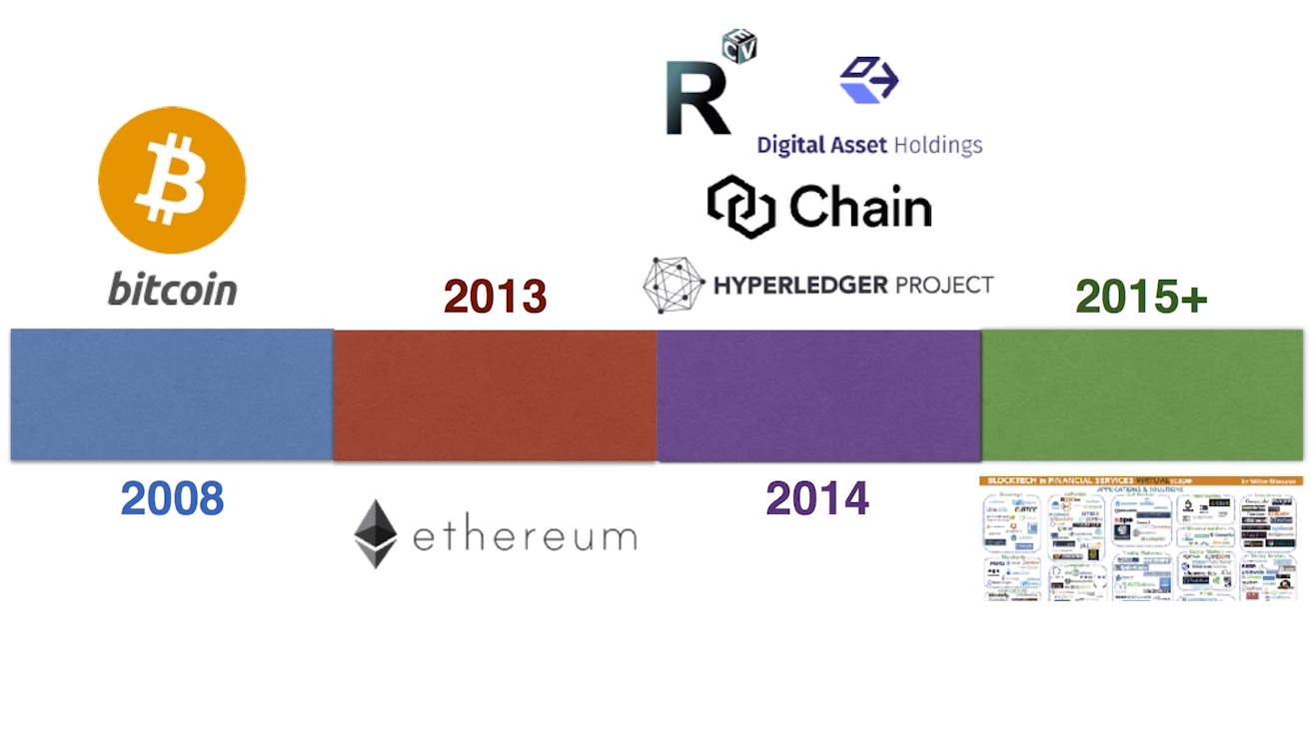
Blockchain Technologies
Notes:
2008
BLKC evolved in 2008 with arrival of bit coin. Bit coin I am sure everyone has heard about it. Its the first decentralized crypto currency.
Prior to Bitcoin other crypto currencies have been proposed but none of them have been able to solve the problem of having a truly decentralized crypto currency that is not controlled and owned by an individual or a central organization. Big area that bitcoin addressed is ability transact with anyone who you don’t need to trust over an open network.
Way bit coin works is people have public address identifying their wallets and bit coins can be sent from 1 party to another party using these address. Details regarding these transactions are recorded on a transaction ledged so much like your bank ledger. Bitcoin has public ledger that records the Bitcoin transaction going from 1 address to another. That transaction ledger in Bitcoin is termed as a bitcoin block chain. We will get to the details of this later.
Bitcoin In order to write transactions on the Bitcoin blockchain bit coin has a simple scripting language. Because it was created only to write transactions on Bitcoin ledger that was very primitive language and does not support elaborate programming Ex: You cannot write loops with bitcoin scripting.
2013 ETH
Considering the issues with the limited programming support on BitCoin blockchain.
Vitalik Buterin came up with the idea of a platform that would go beyond the financial use cases allowed by bitcoin. He released a white paper in 2013 describing an alternative platform designed for any type of decentralized application developers would want to build. The system was called Ethereum. Idea was that he wanted to build a platform that could support running programs off the block chains. That was first significant milestone for wide adaptation of Blockchain as a technology for multiple purpose.
2013 - 2014 Ripple.
Shortly after Ethereum another blockchain technology variant came along called Ripple is used for inter organization payments.
2014: Hyper Ledger:
In 2014 things started to pick up a bit. Consortium on 70 major banks was formed and they put money in a company called R3 whose purpose was to find application of blockchain technology. They developed their own version of blockchain technology called Corda which is also called Digital Asset holding.
Then there was another blockchain variant started by a team in Sanfrancisco called Chain.
Then there was a block chain variant Hyper Ledge Fabric was launched by Linux foundation. Hyper Ledger fabric is an umbrella organization for major blockchain projects where all big blockchain players are involved.
2015 Things really picked up and there was a huge traction towards adaption and development of block technologies in the financial space. There are multiple applications for block chain technologies being identified across industries not just financial sectors. More on this later...

Slide 7
Fundamentals
What is a Blockchain?
How does Blockchain fits in software architecture?
When is Blockchain appropriate?
Notes:
If we take bitcoin as an example what we are trying to do there is transfer crypto currency or funds from one party to another without relying on third parties (Banks). In our current system we need a bank and we trust the bank, they run the software and we trust them that they do everything correctly. But if you want to remove this third party trust you need a peer to peer system.
Very naïve way to start is if we model bank nodes as files. But I can copy the file and give it you, and copy the same file and give it to someone else. So this approach is not going to work as it introduces a double spend problem. So we need a way to this double spend problem and ensure that file is not copied. Blockchain has characteristics to establish peer to peer trust and also address the double spend problem.
Lets start discussing with basic 5 ingredients that are found in every block chain.

Slide 8
State Machine
M:7
M:5
M:-3
M:6
M:11
S0: 0s
T
S1: 7
T
S2: 12
T
S3: 4
T
S4: 10
T
Notes:
First key component of the Blockchain is a state machine. In state machine has few building parts. It has a state, where you start in where you start, you have messages going into the state machine. You have a transition function that takes the incoming message and transforms the state from initial state to new state.
Ex consider an example here where both state and messages are integers. Initial state is 0 and we get an incoming message of 7 so we apply the transition function and go to the new state
Depending on the transition function. We can repeat it again and again with new messages.
In blockchain we have extended the concept of state machine we have added a validation function. Which acts on same parameters current state and message

Slide 9
Blockchain State Machine Validation Function
M:7
V
S0: 0s
T
M:7
M:5
M:-17
M:-3
V
V
V
V
S0: 0s
S1: 7s
S2: 12s
S2: 9s
T
T
T
Notes:
In blockchain we have extended the concept of state machine we have added a validation function. Which acts on same parameters current state and message, it will output a Boolean Value indicating if the message is allowed to be acted upon the current state.
Ex in this case lets say if our validation function marks the incoming message to be applicable if the incoming message value is > current state.
So if you think in money transfer context what would it be? State contains information about balances in the account. Ex if incoming message depicts the transfer from the current account to another account then if incoming message is > current state validation function will not allow the message to be processed as source funds are less than the transfer request.

Slide 10
Distributed Network
Notes:
The next ingredient is a Distributed Network.
Distributed networking is a distributed computing network system, said to bedistributed when the computer programming and the data to be worked on are spread out across more than one computer. Usually, this is implemented over a computer network.

Slide 11
Distributed Network
3
-4
-2
V
V
V
0
T
3
T
1
A
B
A
A
5
-2
5
-4
3
-4
-2
3
-4
-2
V
V
V
V
V
V
0
T
3
T
1
-4
0
T
3
T
1
5
-4
-4
-2
-2
-3
D
C
A
A
-2
-3
-2
3
-4
-2
3
-4
-2
V
V
V
V
V
V
T
-3
-4
T
1
0
T
3
1
0
T
3
Notes:
Lets start by having our distributed network.
Here we have 4 nodes that can represent 4 different persons/parties/organizations, lets use term organization for a node for simplicity. How ever note that its not a scenario like where one organization is running its own database cluster ex Casandra cluster, here we have is system distributed across organizations. As these organizations need to interact for some reasons lets add some communication lines. You need to be able to pass message from one node to the another node. However Not every node need to be connected to every other node as node can forward these messages.
So When a message is sent from Node A to Node B Node B can then forward that to Node C and so and so forth. So eventually the message will propagate to the participating nodes.
So now lets bring in the first ingredient and place it in here. Here you see every node runs state machine by itself.
Lets run through the transaction sample.
As each node runs the state machine on its own (have full copy of blockchain state) and has also performs validation on its own it do not need to trust anyone else for correctness. If any of the dealing parties tries to do something malicious or incorrect then organization can rely on its own state.
This ingredient is need in block chain because a trust mechanism is required and its very difficult rather risk as well to trust anyone else if you are dealing with unknown or partially trusted parties.
However there is still a problem here. Lets have a look.

Slide 12
Distributed Network
A
C
5
-3
-3
5
V
V
V
V
0
1
T
6
T
3
0
1
T
6
Notes:
As the node A saw 5 first and its valid input it transitions to next state 6. Next node A gets -3 it validates it and as state is more than message which I case of money balance is more than withdraw request it is considered as valid. So deduction of 3 is made and next state is reached 3.
Now lets see how node C performs. As node C see -3 message coming in and this is deduction of value more than current state its considered invalid and transition function is not applied to the input. Next it see 5 coming in which is a valid input so transition function which is an add is applied and next state is achieved 6.
At this point in time we see there are different states in the network, so how can a consistency be maintained. This brings us to the next ingredient of block chain.
Consensus.

Slide 13
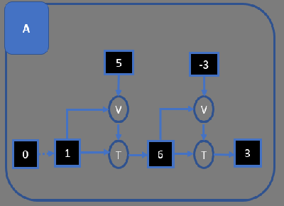
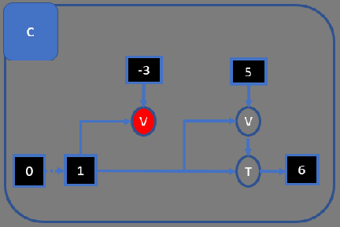
Consensus
VS

Slide 14
Consensus
How do you ensure that data is consistent across the network?
Consensus = Protocol by which peers agree on state.
Ensures all peers in the network has exactly the same state.
Fraudulent transactions kept out of the final state.
Guarantees to record transactions in chronological order.

Slide 15

Consensus By Lottery
A
B
A
A
3
-4
3
-4
V
V
V
V
0
T
3
0
T
3
D
C
A
A
3
-4
3
-4
V
V
V
V
0
T
3
0
T
3
Notes:
In consensus by lottery scheme every node in the blockchain network is assigned a set of lottery tickets. At the time when consensus is required a lottery ticket is chosen for deciding the winner. The node with the winning lottery ticket decides what is the correct progress state. It broadcast the info about the correct state. If any node is in agreement with the state announced by node holding the winning ticket they are good. If however any node is in state that does not match with the progress state picked by the winning lottery holding node, the conflicting node resets its state to the state announced by the winning/deciding node for that cycle.
For bit coin every hash that is tried to fulfill the difficulty criteria is a kind of lottery ticket if it satisfies the difficulty criteria the first one that found it wins.
We will discuss this concept when we get to bitcoin details.
Consensus by Lottery scheme is mostly suitable for public blockchains where anybody can join in. Ex Bitcoin Blockchain.

Slide 16
Consensus By Vote
A
B
A
A
3
-4
3
-4
V
V
V
V
0
T
3
0
T
3
D
C
A
A
3
-4
3
-4
V
V
V
V
0
T
3
0
T
3
Notes:
This kind of consensus scheme is used in a closed blockchain where you know who all are the participants. Ex within organization departments or inter organization blockchains.
In this scheme a someone is selected to propose a state and hence an ordering of states to move forward, algorithm decides who that node would be it could be round robin it could be some designated node(s). Node proposes a state and if majority of nodes agree then state/progress is accepted. If agreement is not reached some other node is picked by the underlying algorithm.
This protocol is not suitable for public blockchains.
So consensus is our third ingredient. But consensus is a requires a substantial amount of work to be done across the network. If we have to do consensus for every message that comes in it would be a bottleneck. So here we come to our next ingredient of blockchains the Block.

Slide 17
Blocks
BL BLOCK A
M3
M1
M2
BL BLOCK C
M3
M1
BL BLOCK B
M3
M1
M2
M2
BL BLOCK B
M3
M1
M2

Slide 18
Blocks
A
BL BLOCK A
BLOCK B
BLOCK C
M3
M1
M6
M7
M9
M7
M2
M5
M8
HASH PREV
HASH PREV
V
V
V
S0s
S1
S2
S3
T
T
T
Notes:
As consensus is a time and a resource consuming process, for optimization instead of having consensus over a single message, consensus is done for set of messages called blocks.
Look at this way we started at initial state and messages are flowing into the system and at some point / interval consensus has to be done. Nodes goes through consensus on a block, block contains a list of messages. While this consensus is being done new messages can flow into the system. Nodes keeps queueing them and when the next set of consensus starts nodes picks the messages from set of queued messages to create new block and achieve consensus.
Things get interesting if you also add to those blocks the cryptographic hash of previous blocks then we get a chained blocks meaning that each block is also linked and dependent on previous block. With this we get a series of blocks that kind of become immutable as they move deep in history of block chain. We will talk about cryptography and its usage in block chain later.
So now if each node starting at the initial state again and apply same transition and validation function on block of incoming messages, it can come to exact same stage on its own as every other node in the network without there being a need to trust any other node.
So now we have 4 ingredients but we still need one more ingredient.
Example a node A or a person interacting with system via Node A can do what node B or a person interacting with system via Node B wont like.
A can insert a message in network indicating some amount (say 5 Dollars) transferred from B account to A account. But this would be wrong.
So this brings us to the next and final key ingredient of our block chain. Authorization.

Slide 19
Authorization
Read Authorization
Write Authorization
Notes:
Authorization in block chain is segregated in 2 parts: Reading, Writing
Reading part on a public block chain is straight forward, everybody sees everything. However when we would discuss permissioned block chains we would see how and when reading authorizations are applied for involved parties. Also there are hardware level solutions that ensures that encryption and decryption happens on hardware layer so the high level. But that’s part of future discussion.
For now lets assume that we are using a public block chain so everyone sees everything. And this is a consequence of the fact that all messages are propagated through entire network and each node sees every message and process every message on its own, else node will not be able to validate to accept or reject the messages it receive to update its underlying state.
Next is the Write Authorization that is absolutely essential part when it comes to transacting on blockchain. This problem is solved using Mathematical verification using Cryptography. Before we get down to Authorization lets quickly have a look at some basic concepts.

Slide 21
Authorization Writing
Asymmetric Cryptography
Digital Signatures
Validation verifies signature
M1
M2
V
V
S1s
S2s
T
Notes:
Authorization for write process is addressed by use of Cryptography. Block chain uses Asymmetric cryptography for write authorization.
You have a public and a private key using private key you can create a signature and put in a message. And then the receiver using the public key is able to verify that the message has actually written by the intended user by verifying signature and not by someone else.
Now if you have a message here that say sending 10 GBP from Jeans account to Marks account then validation function has to check following things :
Signature is valid that confirms that message is from the intended user.
The private key used is allowed to send the funds from the intended wallet.
There are sufficient funds available to transfer.

Slide 22
Blockchain Ingredients (Summary)
State Machine
Distributed Network
Consensus
Chain of Blocks
Authorization

Slide 23
Blockchain Types
Public: Public blockchain has ledgers visible to everyone on the internet and anyone can verify and add a block of transactions to the blockchain. Bitcoin and Ethereum are the example of the largest public blockchain implementations.
Private: Private blockchain is usually setup within an restricted environment within an organization allow only few selected participants in the organization to verify and add transactions. However transactions are visible to all participants.
Consortium: It is a variant of private blockchain where participants are organizations. Only a group of organizations can verify or add the transactions. Also the ledger can be open or restricted to selected groups. Hyperledger Fabric a variant of blockchain technology can be used to implement permissioned consortium blockchain.
Notes:
There are mainly 3 types of blockchains. Public, Private and Consortium block chain.
Public blockchain is similar to Bitcoin or Ethereum block chain that is open to all and anybody in the world can be part of. In public blockchain anyone can verify and add blocks of transactions if they are the miner. Even if participant is not a miner still they can view all the transactions.
Private blockchains are restricted form of blockchains. They are generally setup within a single organization and usually only a central person or governing body has right to both verify and add blocks of transactions to the blockchain ledger. However transactions are visible to all the participants.
Consortium blockchain is between the Public and Private blockchain. Here instead of a single central person or governing body there is group of people or organizations among the participating organizations that are allowed to verify or add the blocks of transactions to the blockchain ledger.
Transactions in consortium blockchain can be made visible to all or restricted to only relevant participants. Ex: A company dealing with multiple competing vendors for each service may setup a consortium blockchain where company sees everything but the vendors see only the information relevant to their contracts with the company but are restricted to view details on deals of competitors.
Along the way, blockchain - because of its self-policing security - eliminates huge amounts of record keeping, which can get very confusing when multiple parties are involved in a transaction.

Slide 24
When is Blockchain Required

Slide 26

Bitcoin

Slide 27

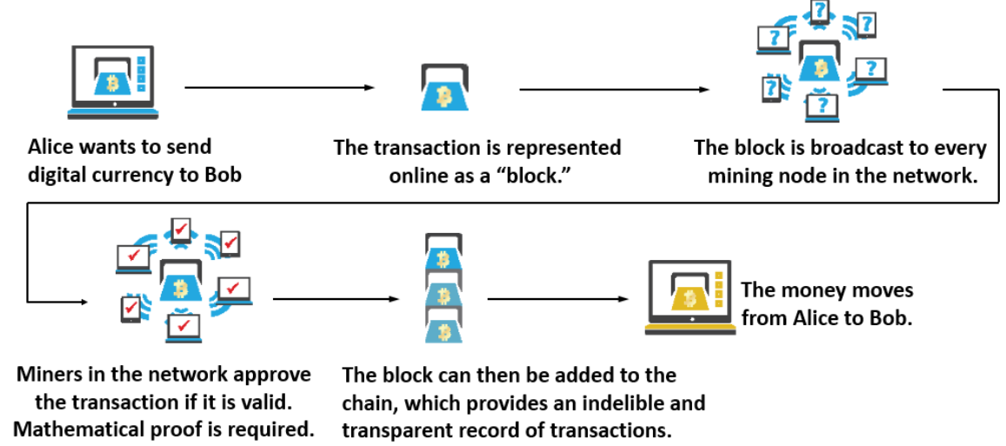

Slide 28
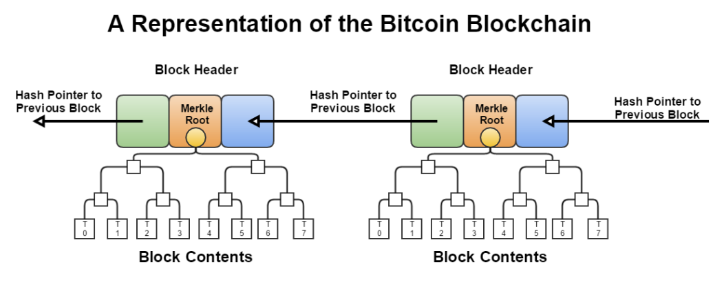

Slide 29
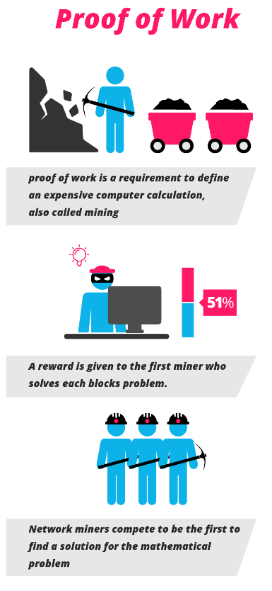
Bitcoin Consensus
Merkel Tree
Difficulty Level
Nonce
Competition
Forks
Longest Chain selection
Miners are rewarded (Transaction Fee + 25 Bit Coins)

Slide 30
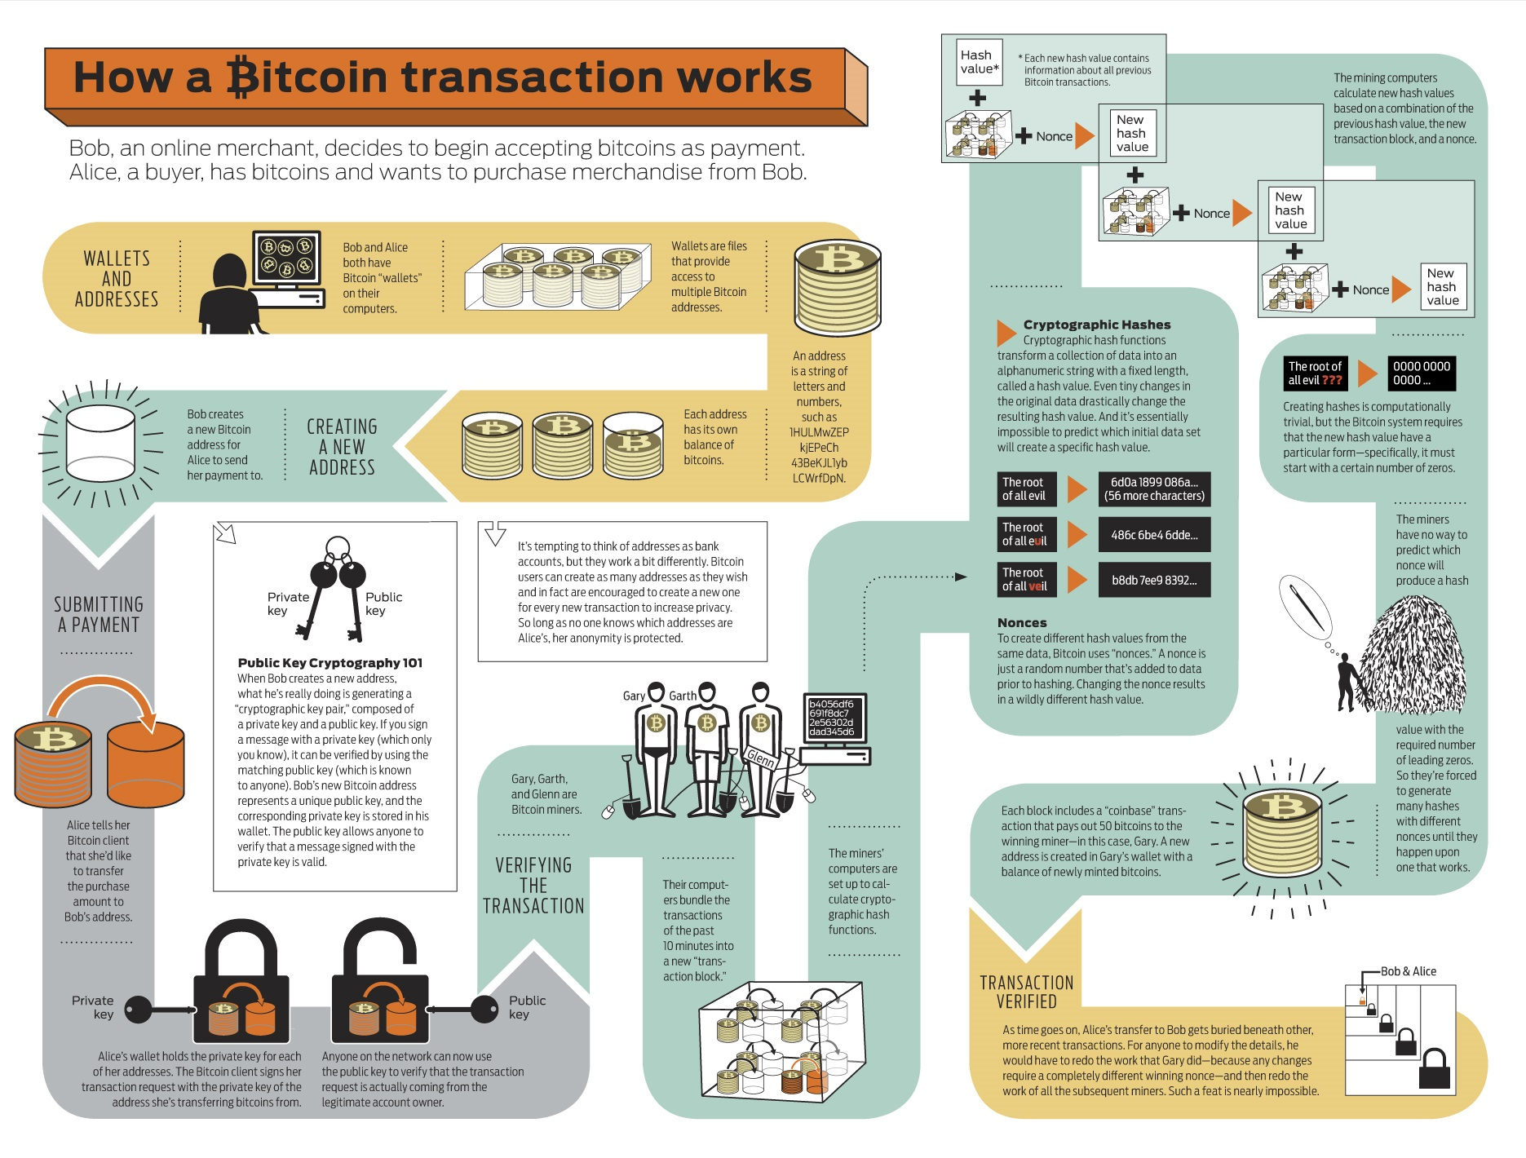

Slide 31
Blockchain Implementation and Use cases
Origination: | Blockchain 1.0 (Transactions) | Blockchain 2.0 (Contracts) | Blockchain 3.0 (Applications)
The concept of a distributed ledger has been around since 1990 2009 Satoshi Nakamoto created Bitcoin and introduced the concept of a blockchain to incarnate a decentralized ledger maintained by anonymous consensus | The deployment of cryptocurrency in application related to cash Currency transfer, remittance and digital payments systems | Financial markets and applications using blockchains beyond cash transactions Smart contracts | Application in areas of supply chain, health, science, government, literature, culture and art and many more …
2008
2008
2012
2015
2020

Slide 32
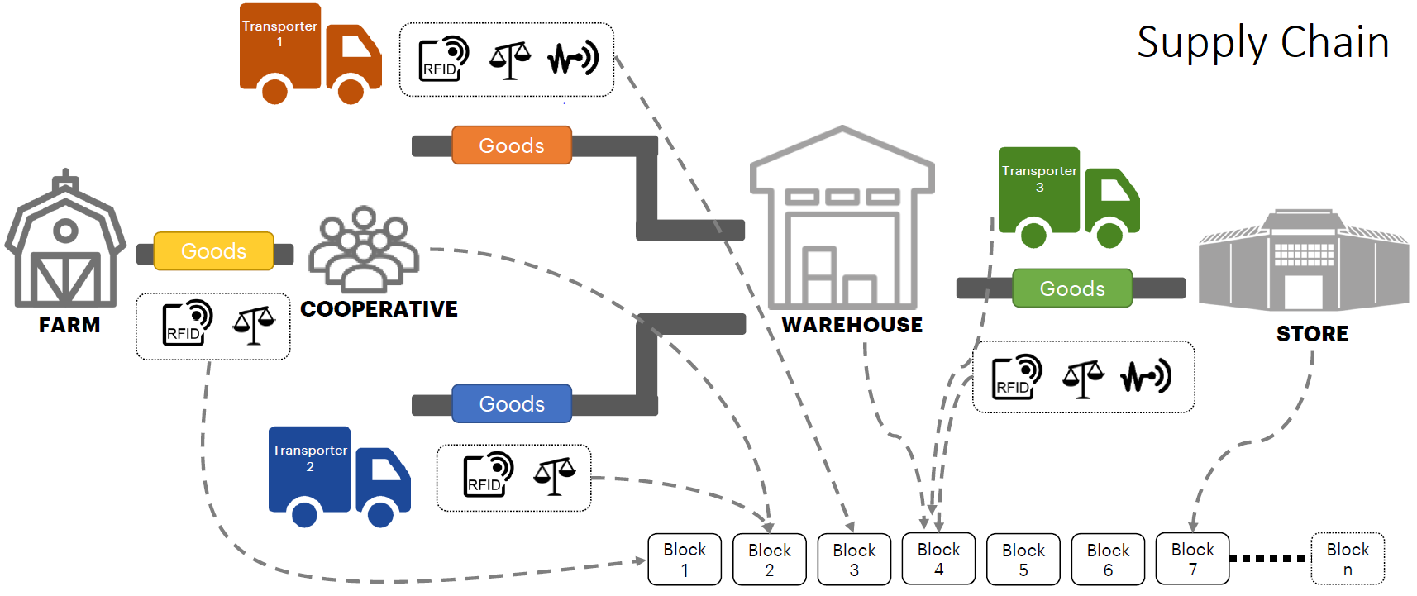

Slide 33
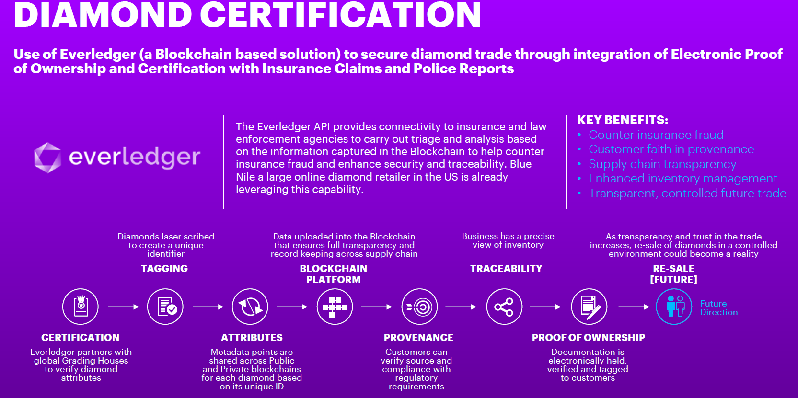
Notes:
Everledger is a company that is working with Dbeers and other companies in diamond industry to build a diamond tracking blockchain. Every company playing a role in diamond industry whether its pulling it out from the ground to processing it on the way to selling it to one distributor to another till the end customer will write to this blockchain whenever diamond changes hands. They would use a tracking number that is specific to a diamond to write information about that diamond.
Now the diamond has a very unique property that when they are held under a light in certain way they create a unique pattern that can be used as a tracking number for that diamond.
At present the diamond industry follows a paper based process called Kimberly process in their terms to track information about diamonds. But the draw back is that it involves manual intervention and it may take days to weeks to track information about diamonds. This is also resulting in introduction of illegally mined diamonds to be introduced in the market.
Using this system to track diamonds to its origin and holders effort is being made to keep blood diamonds out of the market.

Slide 34
References
Accenture Blockchain Academy
Mastering Bitcoin Online Read
Blockchain Introduction Tutorial Video

Slide 35
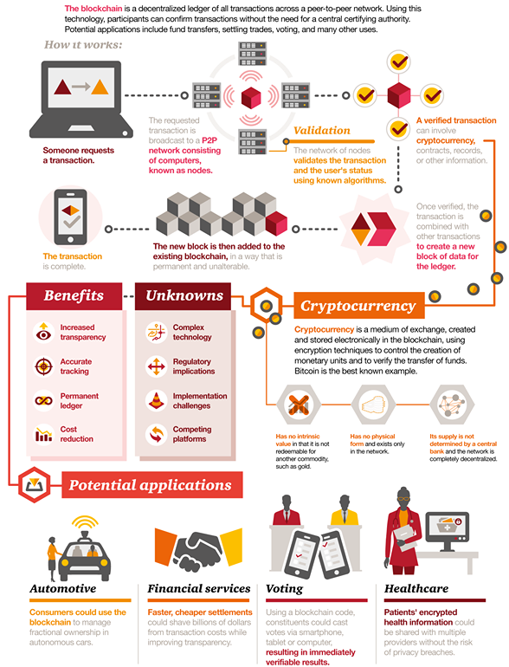

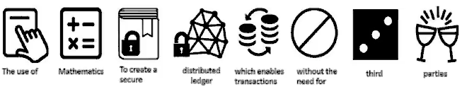
Questions?

Slide 36
Thank You

